Slide 1

ZOMATO DATA ANALYSIS
POWER BI DASHBOARDS

Slide 2
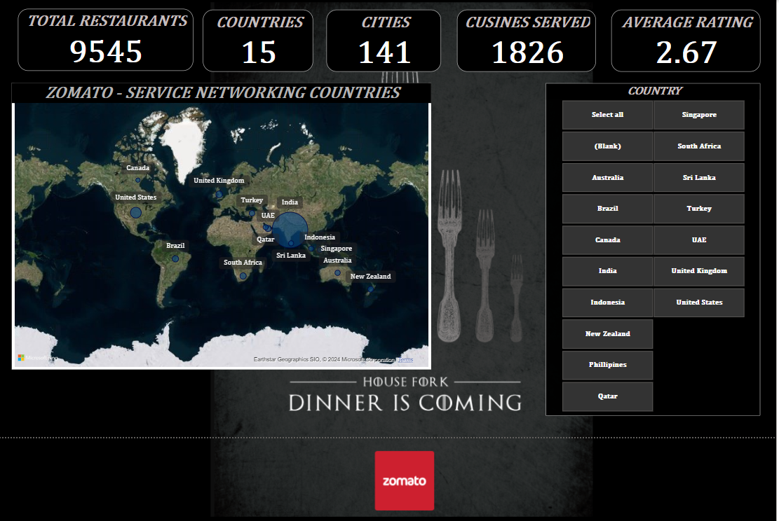
GLOBAL ANALYSIS TAB

Slide 3
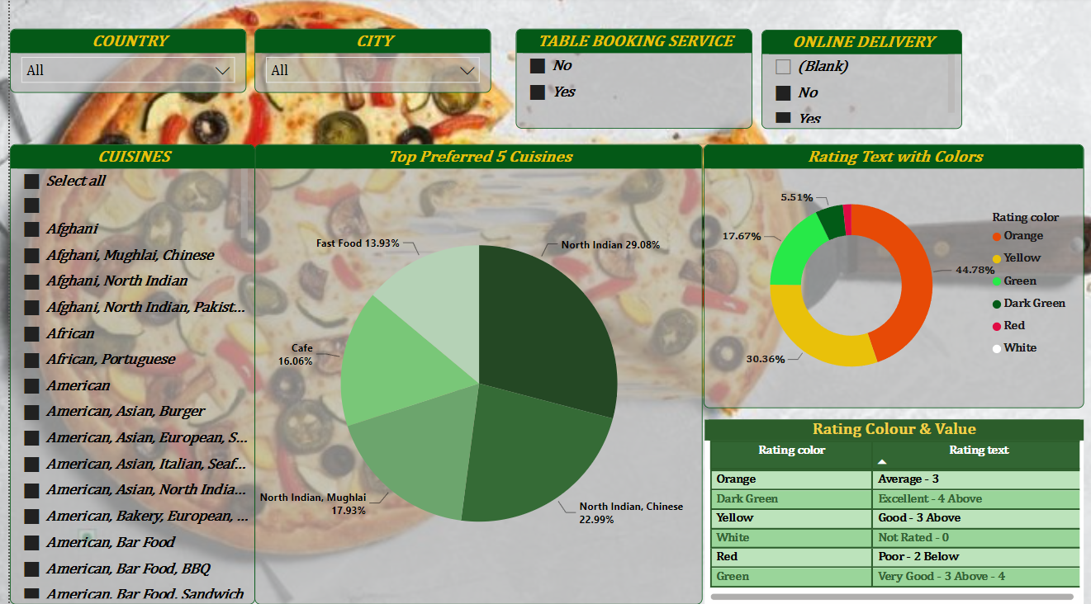
CUISINES INSIGHTS

Slide 4
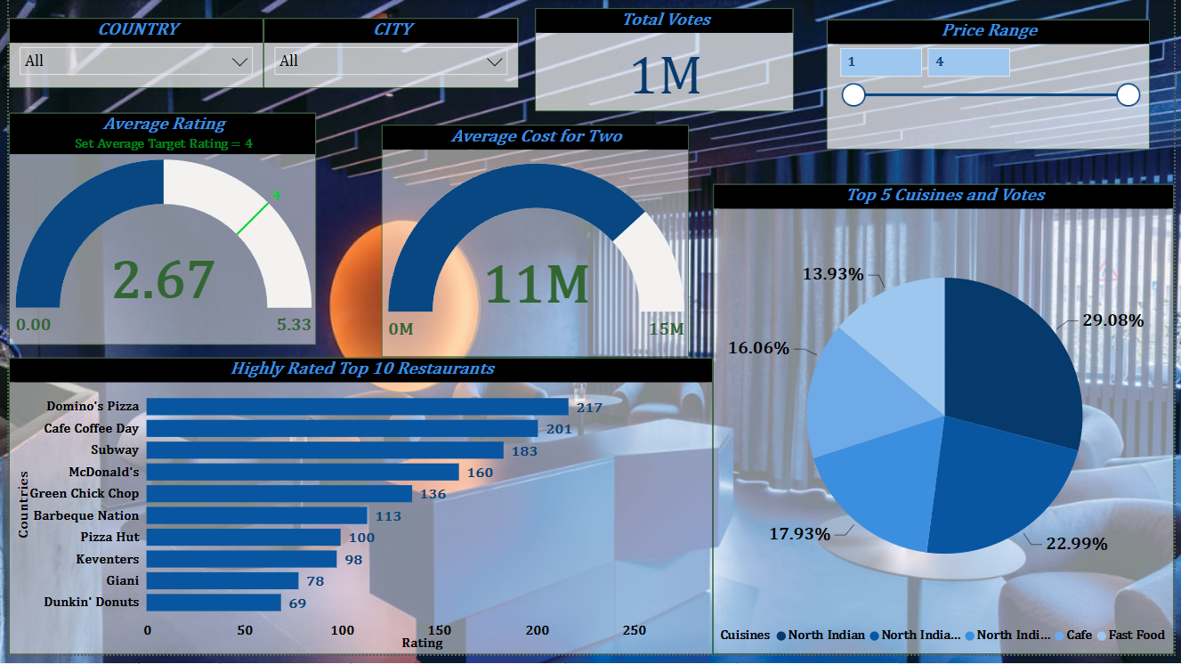
PERFORMANCES INSIGHTS

Slide 5
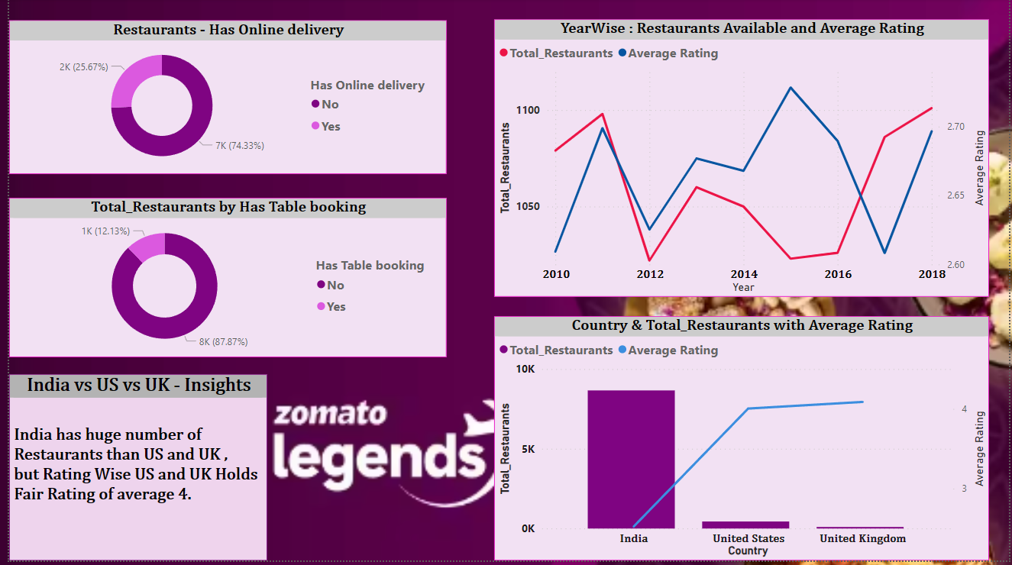
RESTAURANTS INSIGHTS

Slide 6
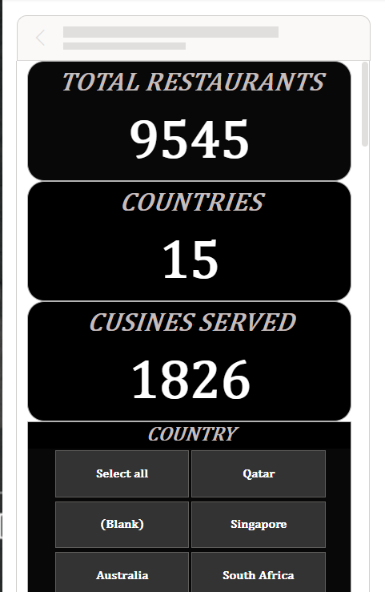
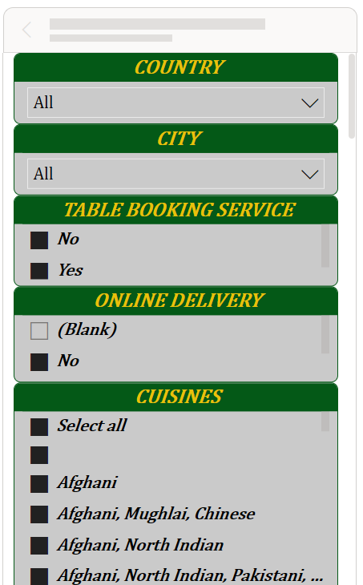
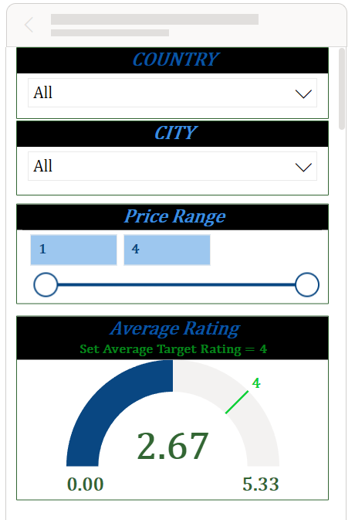
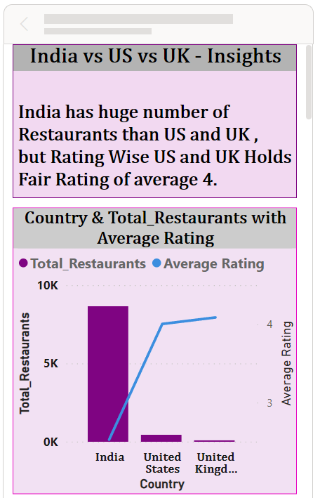
MOBILE VIEWS:

